Slide 1
Computer Basics

Slide 2
For teachers
Link to drive: (shared drive / nextcloud)
20 min presentation, 40 min training
Ask questions before teaching something
Draw similarities to smartphone (program = app)
Constantly spark interest: underline the importance of computers and the specific topic you are talking about

Slide 3
Content
Advanced:
Windows Updates, Defender
Keyboard shortcuts (Windows, Office)
File extensions, hidden files
Cmd, powershell
Registry
Appdata
External storage, partitions, file systems
10 finger typing
Bits and bytes, file sizes
Use computer with keyboard and no mouse
Troubleshooting problems (restart program or computer)
Speed up computer (Disable programs from startup, defragment disk, delete unused files, uninstall unused programs, update drivers, upgrade hardware
Backup and restore (copy files, backup windows)
Boot into safe mode (shift click on restart)
Adblocker
VPN
Virtual machines
Importance of computers (history and future)
Parts of a computer
How to use a computer (mouse and keyboard)
Windows and programs
Start menu
Settings (wallpaper, language, keyboard)
Explorer
Drives, files and folders (structure, create, copy, delete)
Programs (installing, uninstalling, multitasking)
Internet and e-mail
Theory (network, www)
Browser
Search engines (google, bing, booksearch, image search)
Websites (wikipedia, youtube, whatsapp web, facebook, free courses)
Downloading and uploading
Webmail (create account, write e-mail, attachments, spam, virusses)
Media (streaming)
Office programs
Word, Excel, Powerpoint

Slide 4
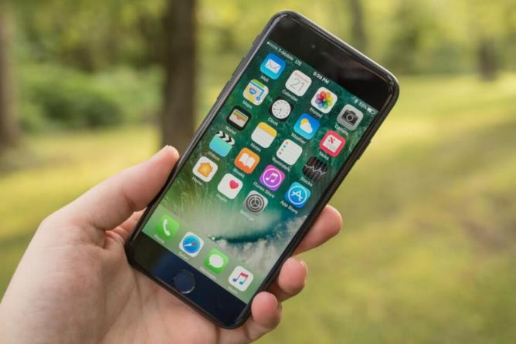
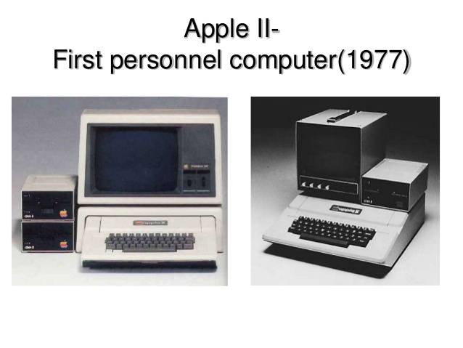
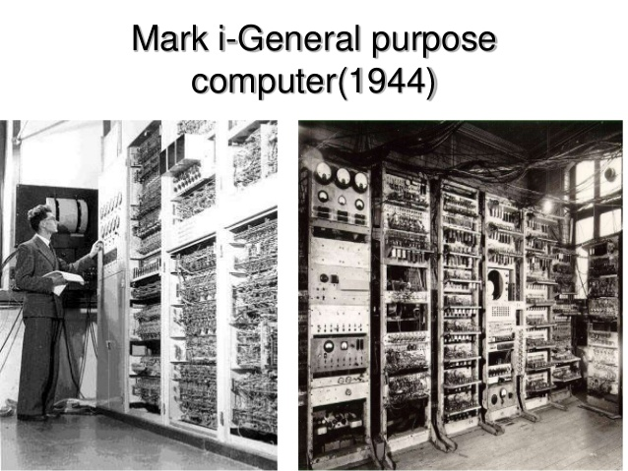
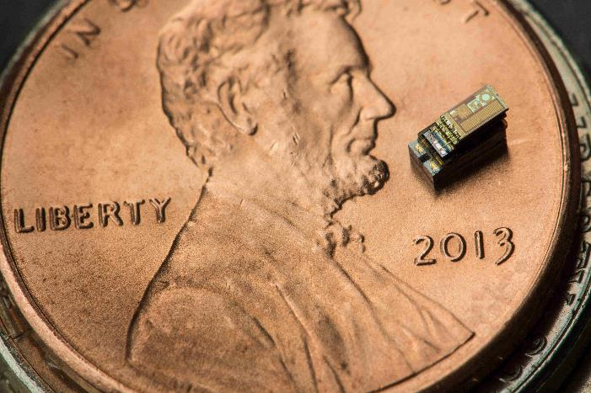
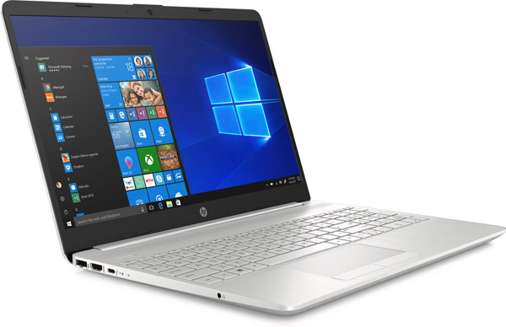
Importance of computers
History of PCs
1941: first computer
1977: first PC
1989: first laptop
2007: first iPhone
2020: smallest computer
Smaller
More complex

Slide 5
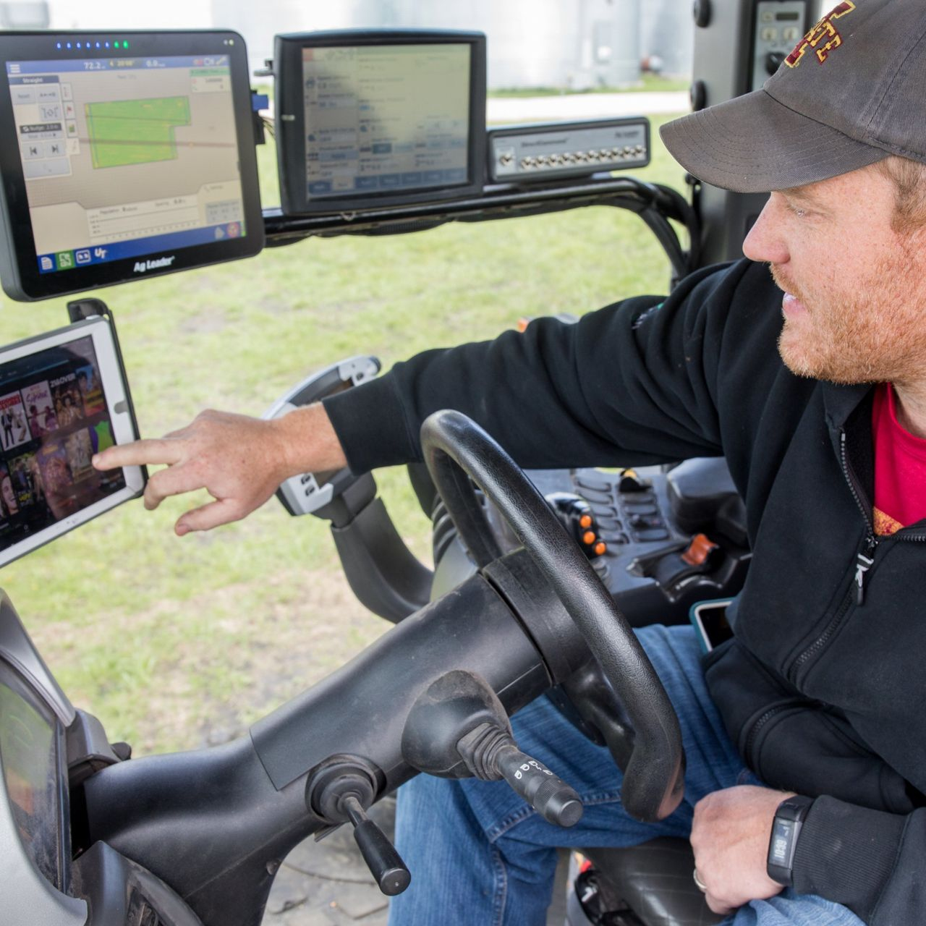

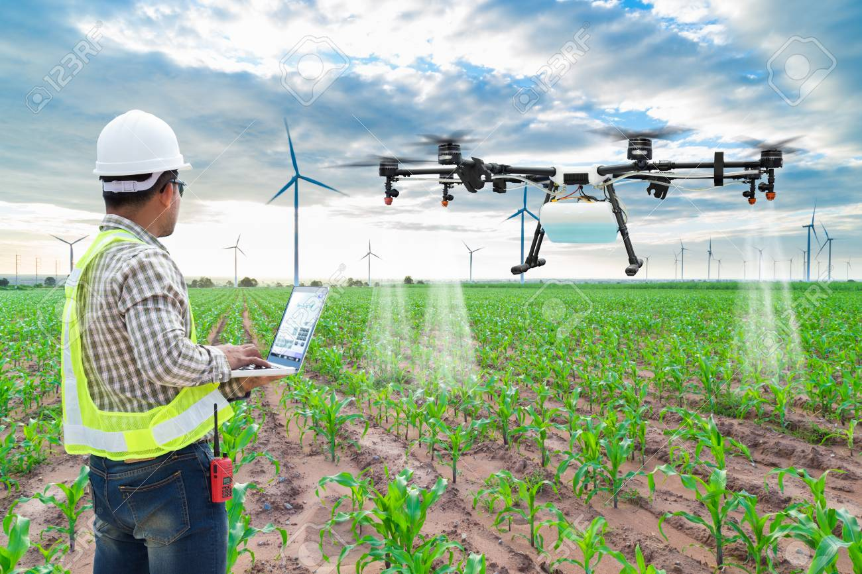

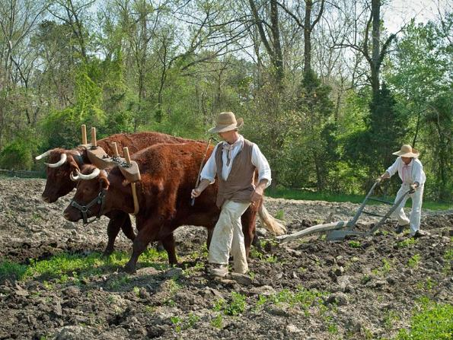

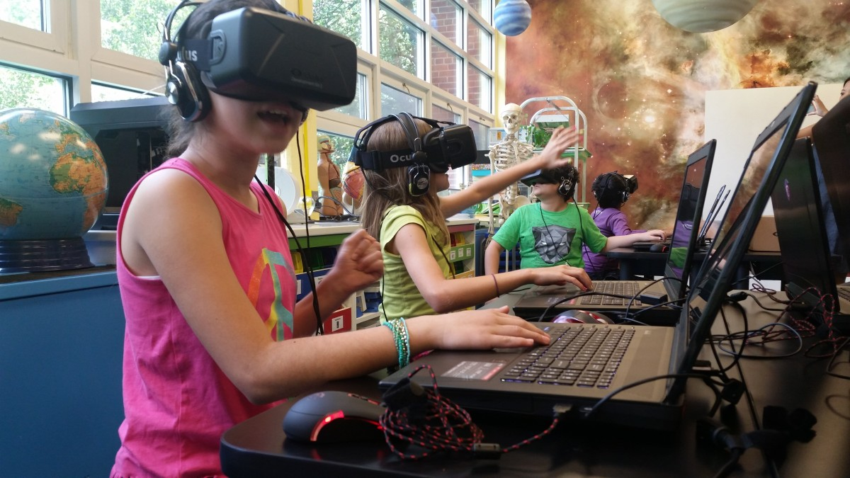
Importance of computers
Job examples then and now
Computers are everywhere
Everyone is affected

Slide 6
Importance of computers
What can you do with a computer?
Communicate (chat, e-mail, forum)
Research (online classes, ecyclopedias, tutorials)
Use office programs (writing, presenting, calculating)
Watching, editing and creating pictures
Watching, editing and creating videos
Playing and creating games
Listening to and creating music

Slide 7
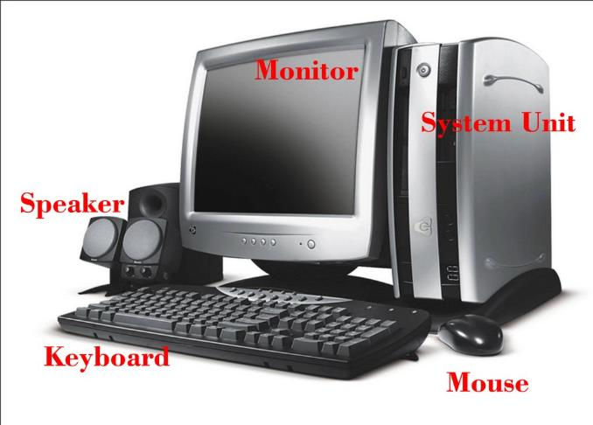
Computer parts

Slide 8
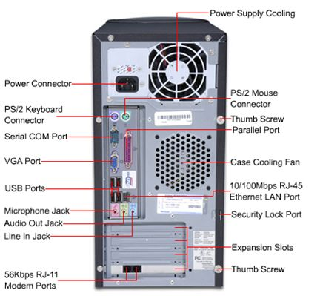
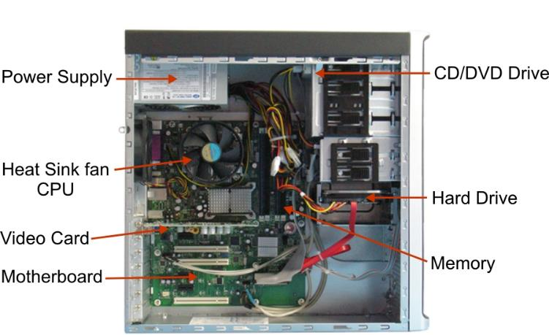
Inside a computer

Slide 9

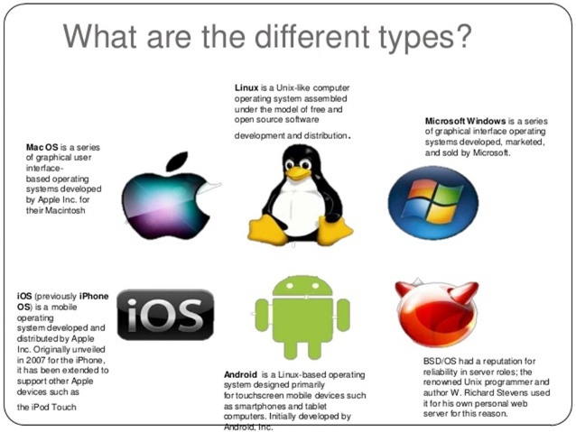
Windows and Programs
Operating system
Types
Tasks

Slide 10


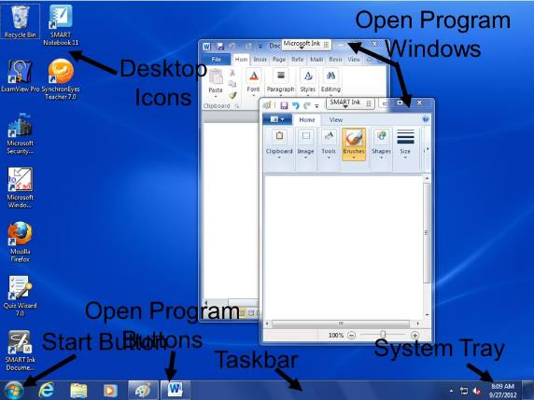
Windows and Programs
Desktop = working area
Parts:
Desktop icons (shortcuts, documents)
Start Button
Taskbar (open program buttons)
System tray (info, notifications)
Open programs

Slide 11
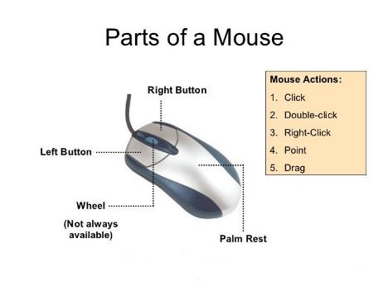
How to use a computer
Mouse:
Point
Click: select file, activate window, focus on textbox
Click: (icon in start menu) start program, (link) open link,
Double click: open file, start program, select text
Right click: context menu (desktop, file, folder, website, window, taskbar…)
Hold click: move icon, move window, select more text

Slide 12
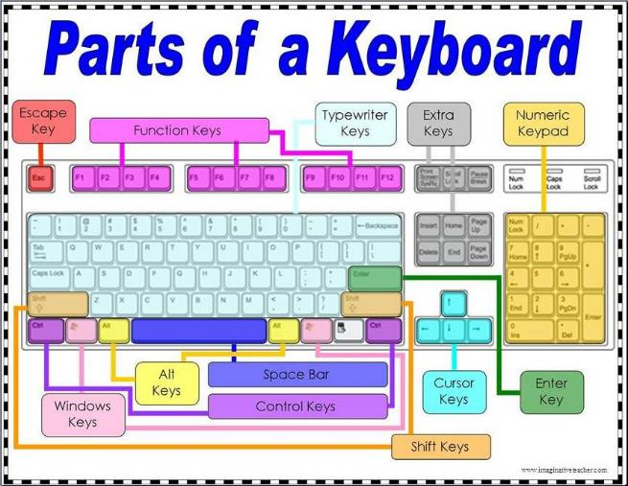
How to use a computer
Keyboard
Mainly for typing
shortcuts

Slide 13

TASK: Windows and Programs
There are always several ways to do the same task!
Learn how to use the mouse and navigate through windows:
Open the file explorer and minimize it to the background
Open Paint, maximize it and write your name with a colour of your choice
Pin Paint to the taskbar
Open notepad and type “hello world” and save it to the desktop
Rename that file afterwards (how many ways to rename a file do you know?)
Put two file explorer windows next to each other
Create a new folder on the desktop and move the file into that folder

Slide 14
Windows and programs
Examples to close program:
Press x upper right corner
Press right click in taskbar and press close
Press right click on window title and press close
Double click upper left corner
Press alt+f4
Open task manager and kill the program (not nice)
Cmd taskkill /im

Slide 15
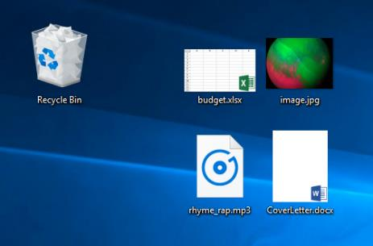
Windows and programs
Explain folder structure (C: drive, programs folder, user folder)
Explain different file types
pictures, videos, music
Shortcuts
Folders
installation files
configuration files, system files
…
Explain difference between copy and cut

Slide 16
Task: windows and programs
Backup pictures from phone
Create textfile (notepad) on computer and copy it to your phone
Delete the textfile and recover it from the recycle bin
Search for word.exe

Slide 17
Windows and Programs
How to undo mistakes (recycle bin, menu undo, ctrl + z, press backspace)
How to use integrated help (menu or f1)
How to update windows and scan for viruses (defender system scan and rightclick scan folder or file)
How to create a screenshot (snipping tool; press print and paste into paint)
Check task manager and kill a program

Slide 18
Windows and programs
Useful programs:
Office (word, excel, powerpoint)
PDF software (adobe)
Media player (vlc)
Paint (paint.net)
Browser (firefox)
Free software vs paid software. (Advertising, pro versions, commercial use)
Open source vs closed source.
Installed program, vs portable program vs web app

Slide 19
Task: Windows and programs
Find a free image viewer
Download and install it
Set the new program as default image viewer
Check how much ram it uses
Uninstall the new program

Slide 20
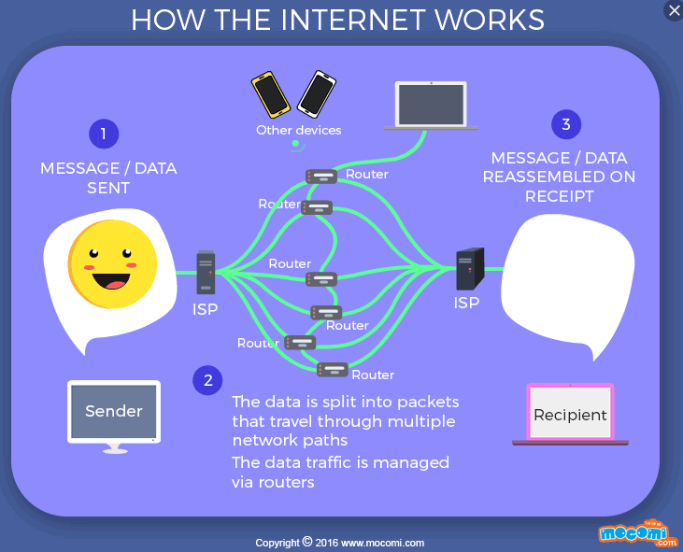
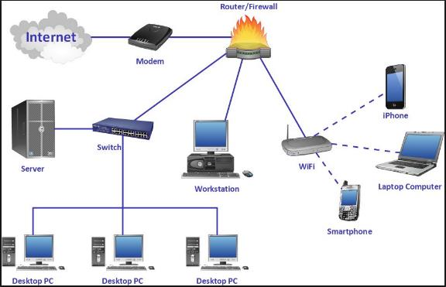
Internet and e-mail

Slide 21
Internet and e-mail
perform a raceroute to wikipedia.org (shows how many network „hops“ a ping does from your computer to the address)
Notes:
Cmd tracert wikipedia.org

Slide 22
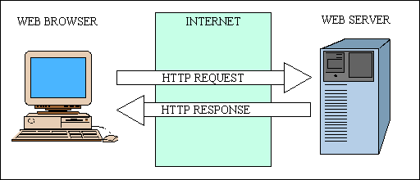
Internet and E-mail
Browser = program
Shows websites
Manages downloads
Saves bookmarks
Manages cookies
Website = interactive document
Hosted on computers around the world (all connected via internet)
Can contain text, pictures, videos
Written in specific HTML code

Slide 23
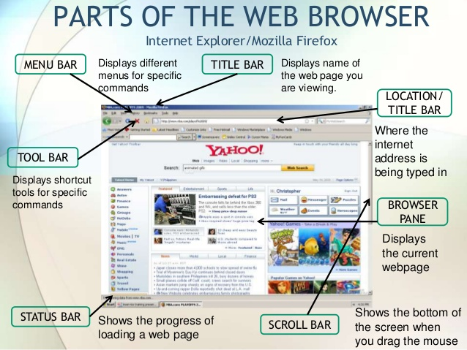
Internet and e-mail

Slide 24
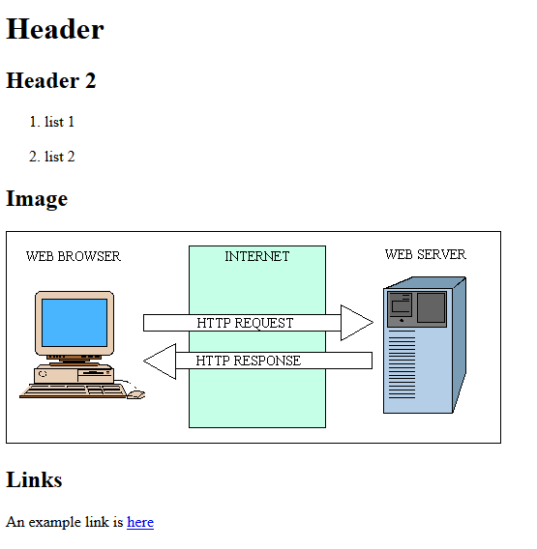
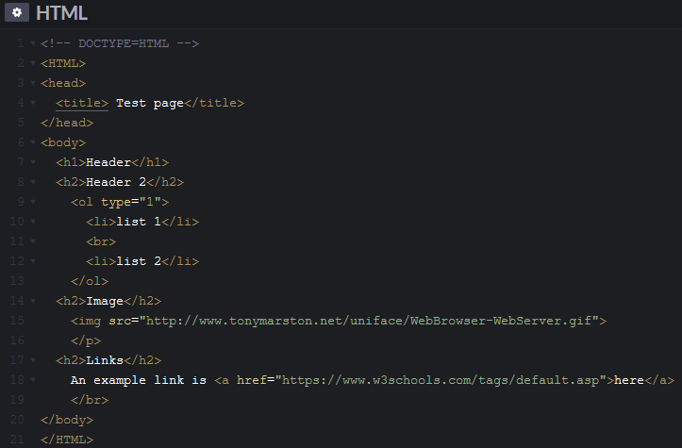
Internet and e-mail
Source code of a website

Slide 25
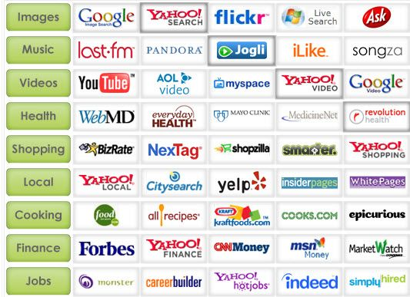
Internet and e-mail
Search engines index all available websites
Search engines don‘t store any information, they just point you to the destination
Use specific words, not sentences
How to set search language for google

Slide 26
Task: Internet and e-mail
Search for the weather (with rainradar) on Lesvos
Create a new tab and search for the opening hours of the cinema in Mytillini
Create a new browser window and search for an English - Farsi translation site
Search how many people live in Greece
Search what scabies is and how to prevent it
Search for a tutorial video how to edit photos
Search how to multiply numbers in Excel
Search why the sky is blue
Search for a blog about a topic that interests you (hobby)
Bookmark a website that you liked
Find the setting for the home page

Slide 27
Internet and e-mail
Website categories:
News
Online shops
Blogs
Forums
Portals
Content sharing
Search engines
Web apps
Social media
Wikis
Web games
Mentionable websites
Wikipedia
Khan Academy
TED

Slide 28
Internet and e-mail
Awareness
Everything you do can be traced (mousemovements, clicks, search history)
Mostly for advertising
Everyhing you once publish on the internet, can not be deleted (wayback machine)
Some websites contain illegal content
Some websites contain harmful content (viruses)

Slide 29
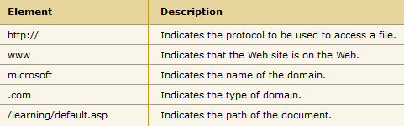
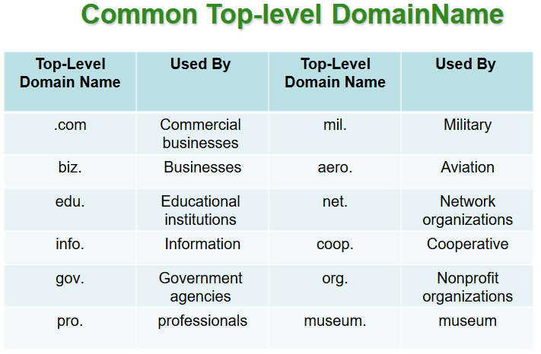
Internet and e-mail
Address bar: URL
(Uniform Resource Locator)

Slide 30
Task: Internet and e-mail
Don‘t waste your time!
Learn!
https://www.thewikigame.com/
https://www.learninggamesforkids.com/geography-games/europe/sc_whichword_europe.html

Slide 31
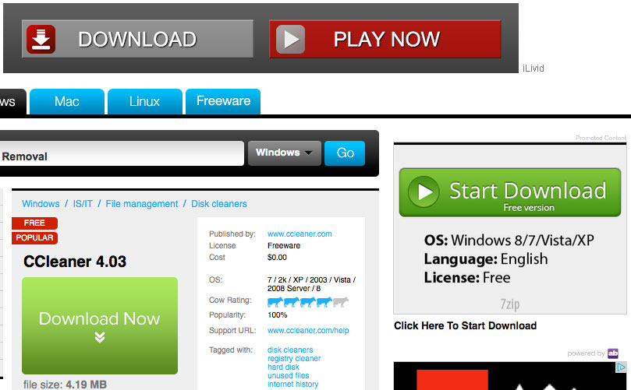
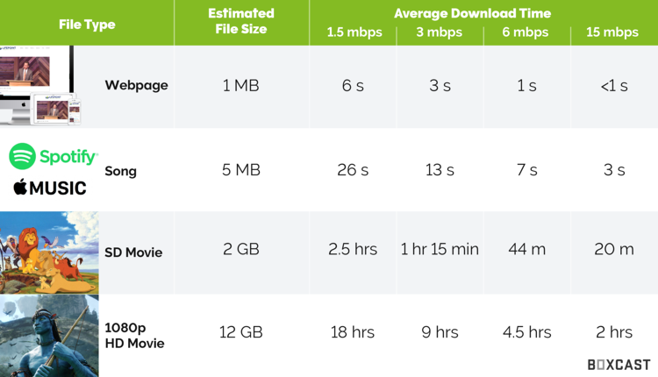
Internet and e-mail
Downloading
Be careful!
Use an adblocker
Default folder: user/downloads

Slide 32
Task: Internet and e-mail
Compare a website with and without adblocker
Install a browser and adblocker on your smartphone
Check the speed of your internet connection
Download a cat or dog picture (high resolution!) and check the progress
How long does it take for a 4MB file to download, when internet speed is 2mbit/s (8 bit = 1 byte)
Notes:
4mb= 4000000 byte = 32000000 bit
2mbit= 200000 bit
32000000/2000000 = 16 seonds

Slide 33
Internet and e-mail
E-Mail = electronic mail (send and recieve messages and attachments)
E-Mail address contains „unique.name@provider.topleveldomain“
Providers = google, microsoft, yahoo, … (or your own website)
Difference to instant messager:
easier to save and organize (subject, folders)
Slower
Can be different providers (chat partners need to have the same app)

Slide 34
Task: internet and e-mail
Create an e-mail account with google
Choose a serious name if you use it for serious communication, choose a random name if you want to use it to stay anonymous
Choose a strong password you can remember (long better than complicated. Never use the same password twice)
Create a folder „work“ „shopping“ „friends and family“
Write an e-mail to your neighbour student

Slide 35
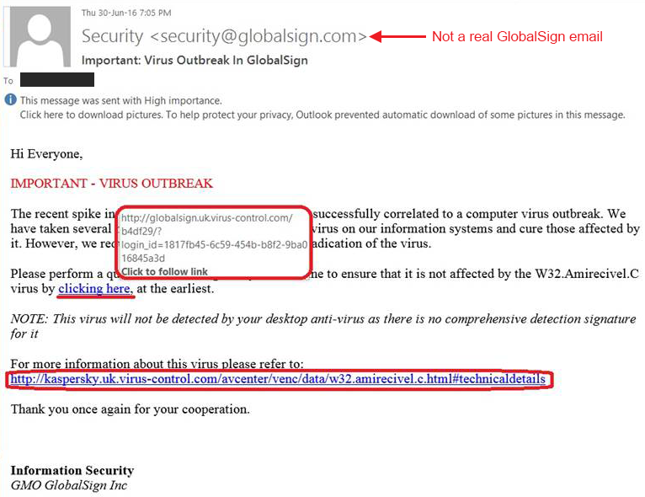
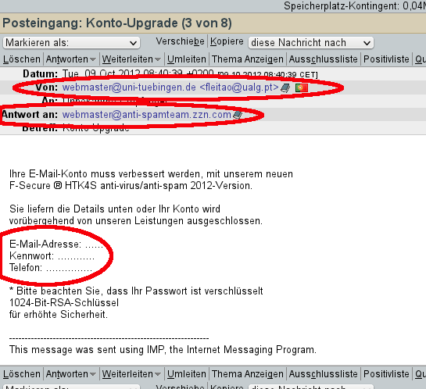
Internet and e-mail
Awareness
Spam (from compromised websites)
Newsletters after signing up, can be unsubscribed
Links to dangerous sites (check the url, check the sender)
www.dog-pictures.com
Attachments with viruses (scan attachment first)

Slide 36
Task: internet and e-mail
Send an e-mail to your neighbour student with a picture inside the text and another picture as attachment (email not bigger than 1MB!)
Answer to an e-mail with a link to a website that you like
Dont forget to sort your e-mails into folders
Forward your neighbours e-mail to two other neighbour students at thee same time
Delete an e-mail and recover it from the trash bin
Check if you have spam e-mails

Slide 37
Internet and e-mail
Answers are often automatically put together in a „thread“
They also include „re:“ in the subject
Your inbox might be several gigabyte big. Enough for textmails, not for big files.
Max file size of e-mails around 50MB
Sharing bigger files requires uploading them and sharing a link
Dropbox, wetransfer, youtube

Slide 38
Media
Streaming
Video: youtube, vimeo, …
Music: spotify, internetradio
Websites or programs/apps (more features)
Lots of data (check wifi)

Slide 39
Tasks: media
Search for an internet radio station with jazz music
Compare two youtube channels dedicated to photography tips

Slide 40
Office programs
Microsoft Office
Word, Excel, Powerpoint, OneNote
Alternatives:
Online: Google Drive
Open Source: Libre Office

Slide 41
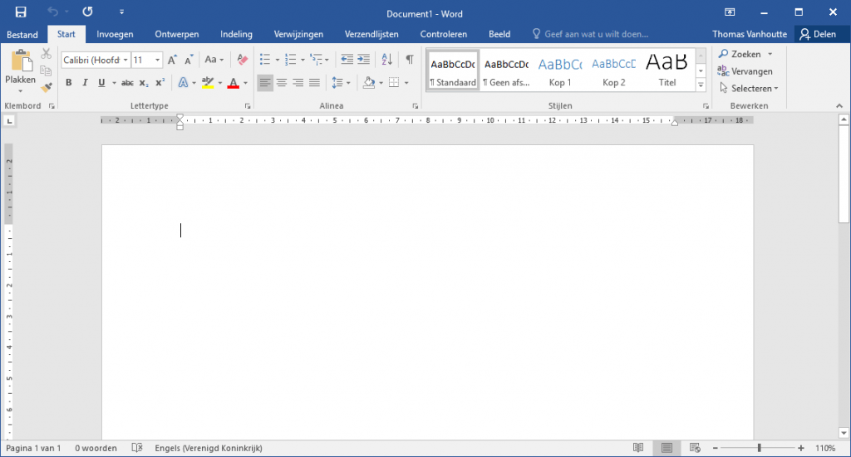
Office programs
Word
New document or template
Write text
Enter = new paragraph
Backspace = delete last letter
Shift = capital letters
Del = delete next letter
Double mouse click = mark word
Click and drag mouse = mark text
Right click on underlined word = check spelling
Ribbons = group of functions to format the text
There is always several ways to do the same task!

Slide 42
Task: office programs
Create a new Word document and save it with your name
Write a sentence what you did yesterday and another paragraph with what you want to do tomorrow
Underline every first word of a sentence
Choose narrow document borders
Insert a bird picture and make it float behind the text
Save this document regularly!
Save it as pdf
Print the pdf

